Slide 1


Slide 2

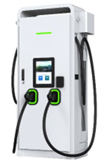
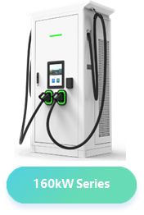
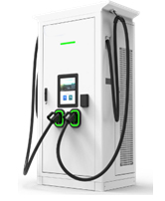
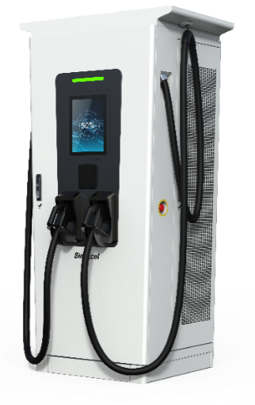
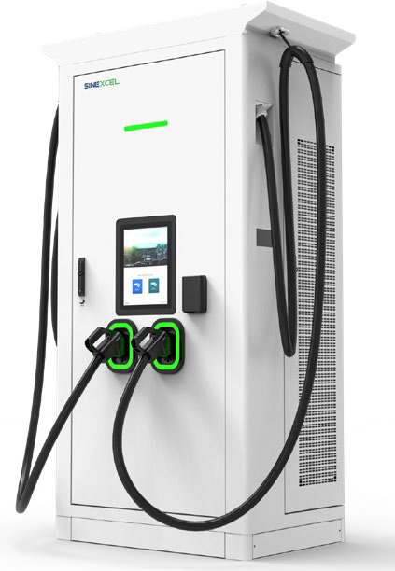

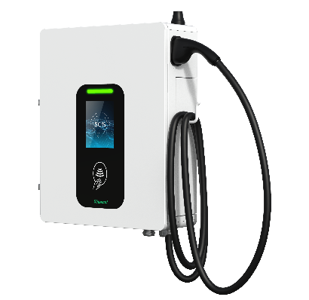












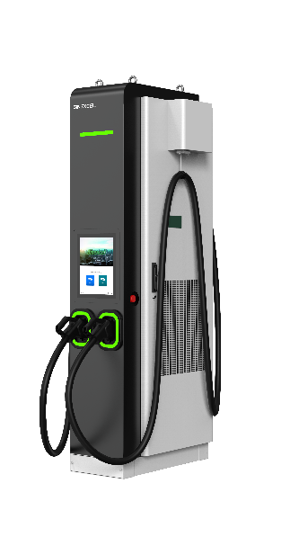
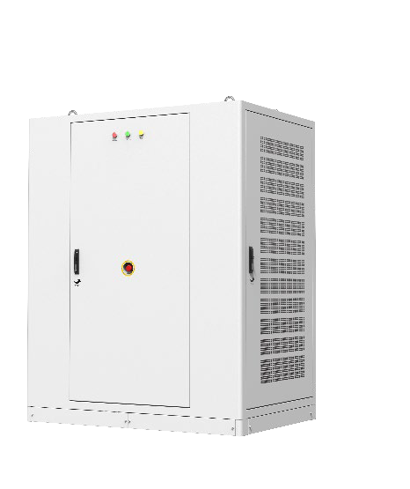
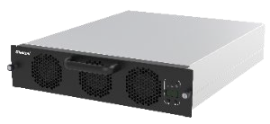
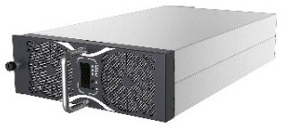
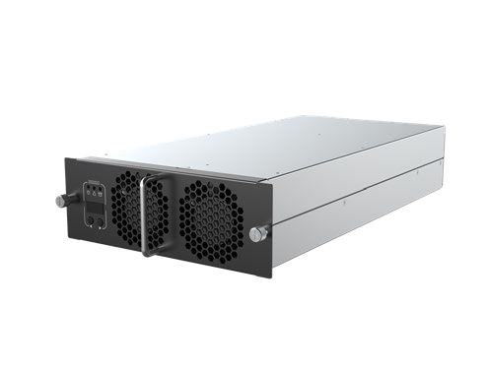
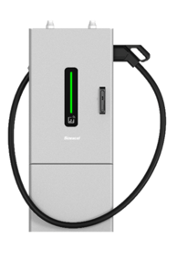






Product Matrix
30kW Series
80kW Series
160kW Series
240kW Series
AC 22kW
Self-Developed Charging Module
480kW Series(Distributed charger)

Slide 3
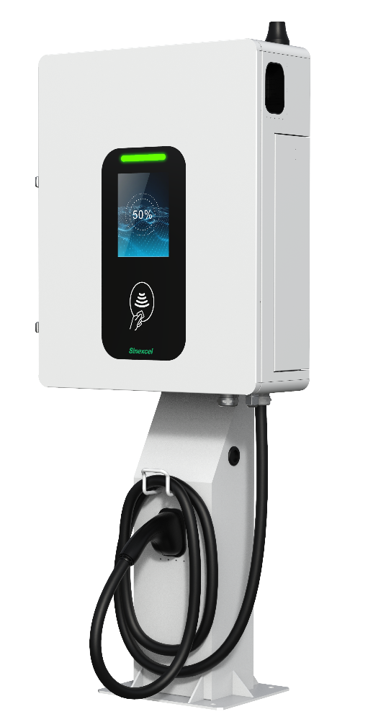


30kW Series DC charger
Output Characteristic | Output Voltage | 50-1000V(CCS2)
 | Rated power | 30kW (CCS2)
 | Max Current | 80A (CCS2)
 | AC->DC Transaction | Power Modules
 | Peak efficiency | 96%
Input Characteristics | Input Voltage | AC 380±10%
 | Frequency | 50~60HZ
 | Power Factor | ＞0.99
 | THDi | ＜5%
 | Grounding Type | TT, TN-CS, TN-S
User Interface | Screen | 8 inch HD high-contrast touch screen
 | Payment method | RFID reader /APP/Credit card (Payter)
Mechanical Dimensions | Protection level | IP55/IK10
 | Standard | IEC 61851, IEC 62196, DIN 70121, ISO 15118, etc.
 | Size | W700*D550*H200 mm
 | Communication protocol | OCPP1.6J
Environmental Conditions | Operating temperature | -25 °C ~+65 °C (derating over 50℃)
 | Humidity | 5%~95% Rh non-condensing

Slide 4


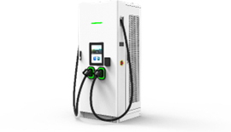


Products | Integrated Charger
Output Characteristic | Rated power | 80kW (CCS2) | 160kW (CCS2) | 240kW (CCS2)
 | Output Voltage | 200-1000V (CCS2) | 200-1000V (CCS2) | 200-1000V (CCS2)
 |  | 200-500V (CHAdeMO) | 200-500V (CHAdeMO) | 200-500V (CHAdeMO)
 | Cable Option | 200A (CCS2) | 300A (CCS2) | 350A (CCS2)
 |  | 125A (CHAdeMO) | 125A (CHAdeMO) | 125A (CHAdeMO)
 |  | *80-240kW DC Charger, Cable Management is optional*
 | Peak efficiency | 96% @half load rate
Input Characteristics | Input Voltage | AC 400±10% (3P+N+PE) | AC 400±10% (3P+N+PE) | AC 400±10% (3P+N+PE)
 | Frequency | 50~60Hz | 50~60Hz | 50~60Hz
 | Power Factor, THDi | ＞0.99, ＜5% | ＞0.99, ＜5% | ＞0.99, ＜5%
 | Grounding Type | TT, TN-CS, TN-S
Certification | Acquired
 | Coming soon |  | Eichrecht Model B Got
Mechanical Dimensions | Size (W*D*H mm) | 850*450*2030 | 1000*700*2000 | 850*750*2000
 | Screen | 15' HD touchscreen | 15' HD touchscreen | 15'' HD touchscreen
 | Protection level | IP55, IK10
 | Standard and protocal | IEC 61851, IEC 62196 | DIN70121, ISO15118 | OCPP1.6, OCPP2.0.1
Environmental Conditions | Operating temperature, Humidity, Altitude | -25 °C to +65 °C (derating over 50℃) | 5%~95% | <2000m

Slide 5

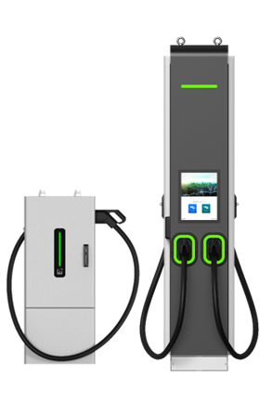
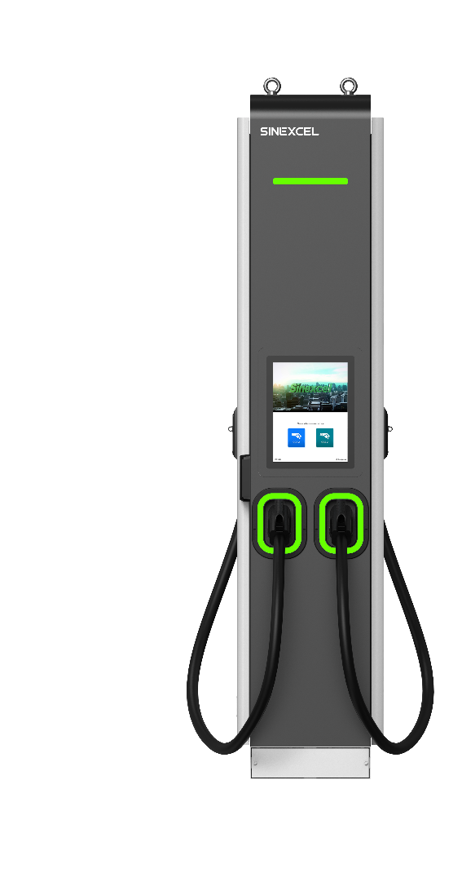
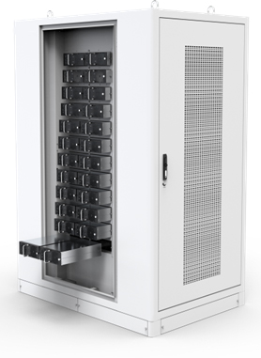
Distributed charger 480（CE）
Output Characteristic | Output Voltage | 200-1000V (CCS2) 200-500V (CHAdeMO)
 | Rated power | 360/480kW (CCS2)
 | Cable Option | 350A (CCS2) 500A liquid cooling (CCS2) 125A(CHAdeMO)
 | AC->DC Transaction | 100020K2C 20kW Modules
 | Peak efficiency | 96% @half load rate
Input Characteristics | Input Voltage | AC 400±10%
 | Frequency | 50~60HZ
 | Power Factor | ＞0.99
 | THDi | ＜5%
 | Grounding Type | TT, TN-S
User Interface | Screen | 15 inch HD high-contrast touchscreen
 | Payment terminal | RFID reader (ISO 14443 A + B to part 4 and ISO/IEC 15693, Mifare 1, NFC)
Mechanical Dimensions | Protection level | IP55/IK10
 | Standard | IEC 61851, IEC 62196
 | Size | Power Bank: W1400*D1000*H2100 mm User Terminal: W750*D400*H2100 mm
 | Communication protocol | OCPP1.6 / OCPP2.0.1(2024) DIN70121, ISO15118
Environmental Conditions | Operating temperature | -30 °C ~+65 °C (derating over 50℃)
 | Humidity | 5%~95%
 | Altitude | <2000m

Slide 6
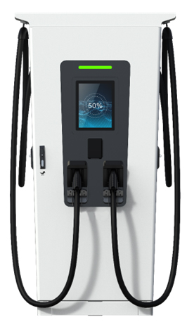

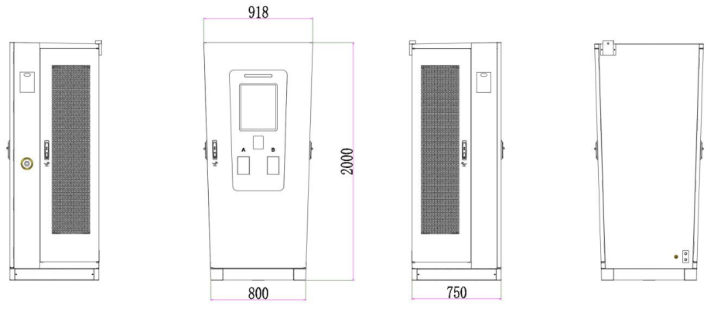
Integrated charger 240
Output Characteristic | Output Voltage | 200-1000V (CCS1) 200-500V (CHAdeMO)
 | Rated power | 160-240kW (CCS1)
 | Cable Option | 300A (CCS1) 125A (CHAdeMO)
 | AC->DC Transaction | 100040K3B 40kW Modules
 | Peak efficiency | 96% @half load rate
Input Characteristics | Input Voltage | AC 480±10% (3P+N+PE)
 | Frequency | 50~60Hz
 | Power Factor | ＞0.99
 | THDi | ＜5%
 | Grounding Type | TT, TN-S
User Interface | Screen | 15 inch HD high-contrast touchscreen
 | Payment terminal | RFID reader (ISO 14443 A + B to part 4 and ISO/IEC 15693, Mifare 1, NFC)
Mechanical Dimensions | Protection level | IP55/IK10
 | Standard | UL 2202, UL 2231
 | Size | W(800~918)mm*D750mm*H2000mm
 | Communication protocol | OCPP1.6 / OCPP2.0.1(2024) DIN70121, ISO15118
Environmental Conditions | Operating temperature | -25 °C ~+65 °C (derating over 50℃)
 | Humidity | 5%~95%
 | Altitude | <2000m

Slide 7
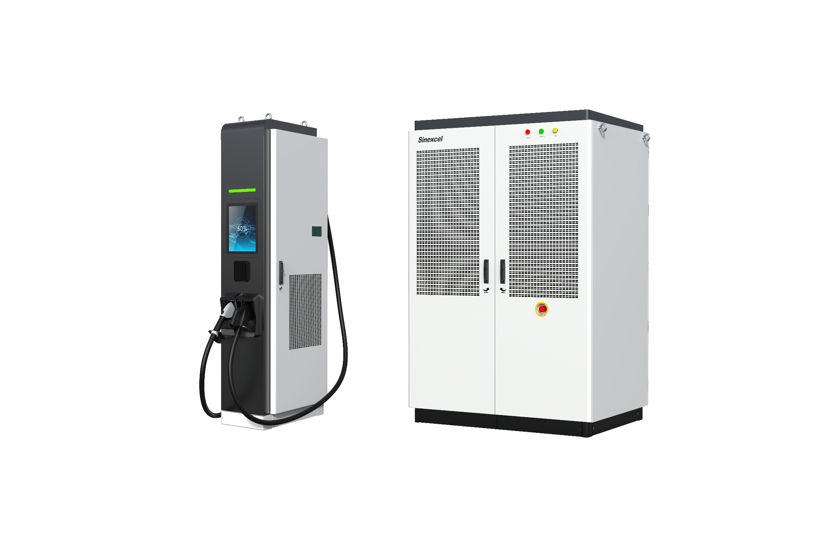
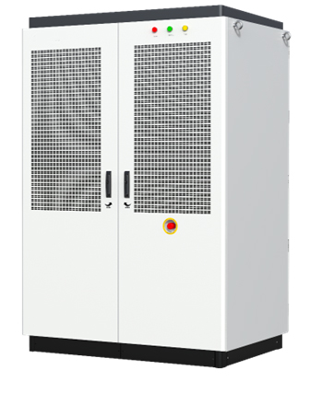
Distributed charger 480
Output Characteristic | Output Voltage | 0-1000V(CCS1) 200-500V(CHAdeMO)
 | Rated power | 480kW (CCS1)
 | Max Current | 300A (CCS1) 500A liquid cooling (CCS1) 125A (CHAdeMO)
 | AC->DC Transaction | 100040K3B 40kW Modules
 | Peak efficiency | 96% @half load rate
Input Characteristics | Input Voltage | AC 480±10%
 | Frequency | 50~60Hz
 | Power Factor | ＞0.99
 | THDi | ＜5%
 | Grounding Type | TT, TN-S
User Interface | Screen | 15 inch HD high-contrast touchscreen
 | Payment terminal | RFID reader (ISO 14443 A + B to part 4 and ISO/IEC 15693, Mifare 1, NFC)
Mechanical Dimensions | Protection level | IP55/NEMA3R
 | Standard | UL 2202, UL 2231
 | Size | Power Bank: W1400*D1000*H2100 mm User Terminal: W450*D750*H2100 mm
 | Communication protocol | OCPP1.6 / OCPP2.0.1(2024) DIN70121, ISO15118
Environmental Conditions | Operating temperature | -30 °C ~+65 °C (derating over 50℃)
 | Humidity | 5%~95%
 | Altitude | <2000m

Slide 8






AC Charger(CE)
For residential use
Product Name | AC Charger - CE
Rated Power | 7kW
Weight(Bare Mechine) | 3.8kg
Cable Length | 5m
Protection Rating | IP65/IK10
Certification | CE, TUV mark, TR25, RCM, UKCA
Communication Method | Bluetooth/Wi-Fi/
Charging Status | LED
User Authentication | Plug and Charge/RFID/APP
Meter | Onboard Metering Capabilities （Class B）
Software upgrate | USB/OCPP 1.6J/APP /Protal
Dimensions | L336*W299*D120mm
Working Temperature | -30℃~+50℃
Operating Altitude | ＜2000m
Color | Snow White
Noise | ≤15dB
Installation | Floor-mounted/Wall-mounted
Grounding Scheme | TN-CS, TN-C, TN-S, TT
Input/Output current | 32A
Input/Output current | Single phase 230V（±10％）
Frequency | 50/60Hz
Humidity | 5%—95%

